Slide 1

IS71030A Introduction to Programming for Games & Interactive Graphics

Slide 2
Reasonable Adjustments (RASA)
Disabilities
Learning Difficulties
Mental Health Difficulties
Mitigating Circumstances
Serious medical condition
Bereavement
Trauma
Unexpected caring responsibilities
Court attendance

Slide 3




Tools

Slide 4
Course Structure
0 | Welcome Week
1 | Course Presentation
2 | Introduction to Unity
3 | Physics & Collisions
4 | Prefabs & Instantiation
5 | Assignment #1 Support
6 | Reading week
7 | Character Controller
8 | Physically Based Rendering
9 | Models & Animations
10 | Canvas
11 | Assignment #2 Support

Slide 5
Assessment
30% | Assignment #1 | 70% | Assignment #2
Marking Scheme
1-9 | 10-29 | 30-49 |  | 50-59 | 60-69 | 70-79 | 80-100
F | E | D |  | C | B | A | A+
Fail |  |  |  | Pass | Good | Excellent | Exceptional
Fail |  |  |  | Pass | Merit | Distinction
Fail |  |  |  | Adequate | Good | Excellent
Fail |  |  | 3 | 2.ii | 2.i | 1
Fail |  |  | Third | Lower 2nd | Upper 2nd | First

Slide 6




Submission
Game
Project
Report
Video
Criteria
Execution
Code & Design
Innovation & Experimentation
…

Slide 7
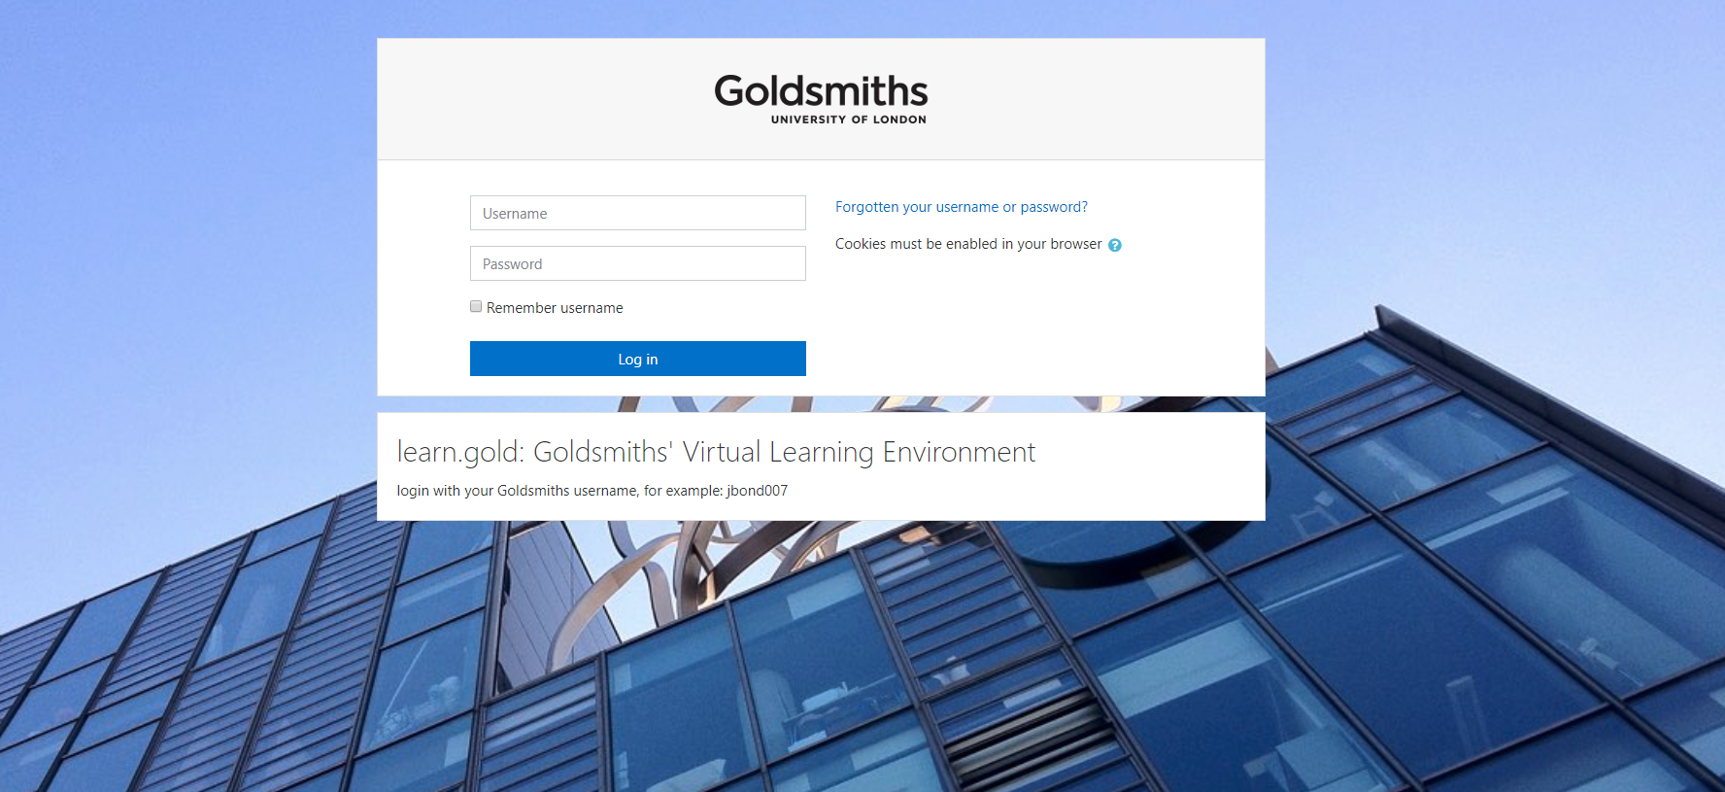

Slide 8
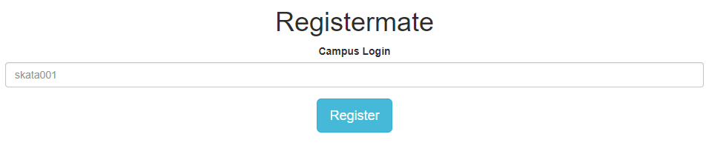

Slide 9


Slide 10
Who are you?
1

Slide 11
What is your background?
2

Slide 12
What do you want to create?
3

Slide 13
IS71030A Introduction to Programming for Games & Interactive Graphics

